Slide 1
Real-time link quality estimation for industrial wireless sensor networks using dedicated nodes
Ruan D. Gomes, Diego V. Queiroz c , Abel C. Lima Filho, Iguatemi E. Fonseca, Marcelo S. Alencar

Slide 2
Outline
Main contribution
The LQE node
The link quality estimator
Validation

Slide 3
Main contribution
The realization of a comprehensive set of experiments in a real industrial environment using IEEE 802.15.4 radios to obtain insights on the implementation of the LQE node
The development of models to estimate the link quality in both directions and the influence of interference, using samples of RSSI and information obtained from received data packets
The design and implementation of a new type of node, the LQE node, and a novel LQE, to estimate the link quality in real-time
The validation of the proposed estimator through experiments in a real industrial environment.

Slide 4
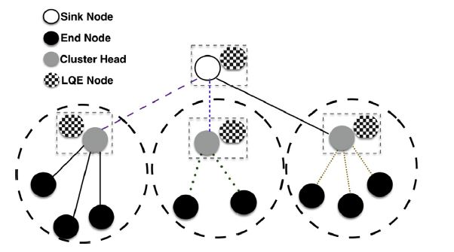
The LQE node
The LQE nodes estimate, in real-time, the quality of the links of the WSN, using a detailed analysis of the RSSI, while the other nodes remain operating normally
The LQE node can also be used to help in the resynchronization process after a channel switch
Raw values of RSSI or LQI are not enough to properly estimate the channel quality, but with a more detailed analysis of many values of RSSI it is possible to identify the problems that affect the channel quality

Slide 5
The LQE node

Slide 6
The link quality estimator
The proposed estimator is executed at the receiver side, and combines three metrics, the P f , C a , and P b .
The Pf is based on the analysis of the RSSI of received packets, and captures the effects of fading and shadowing in the channel quality. It has high correlation with the PRR at the receiver (forward PRR).
The Ca is based on the analysis of RSSI values obtained in periods without packet reception, and captures the influence of interference sources in the channel quality
The Pb is based on the number of duplicate packets received, and has high correlation with the PRR at the transmitter (backward PRR)

Slide 7
The link quality estimator
To analyze the channel characteristics, two metrics were obtained from the RSSI and LQI plots.
The first metric, called Ravg is the mean value of the normalized RSSI or LQI
The second metric, called davg , represents the average variation of the signal in relation to the mean value

Slide 8
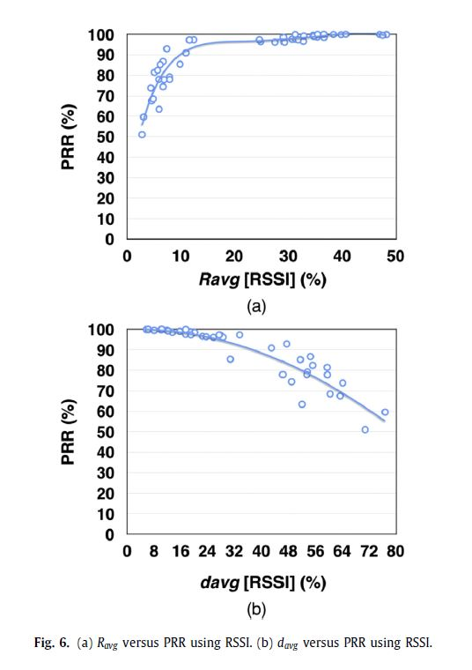
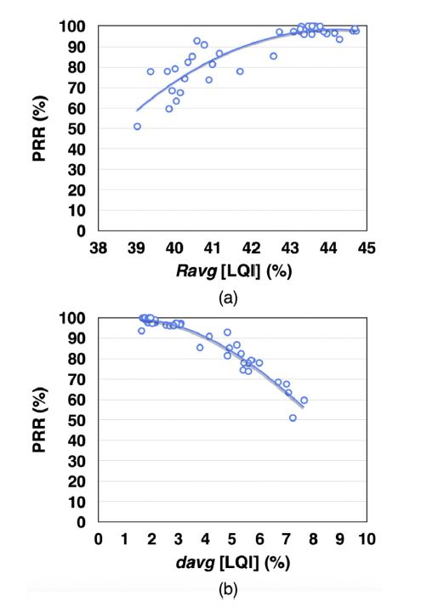
The link quality estimator

Slide 9
The link quality estimator
The implementation of LQI is vendor-specific, which makes difficult to develop a general solution using this metric

